Slide 1
Module 2 Security Mechanisms
Section 2 – Virtualization-based Security
June 2018

Slide 2
.
Part 1 – Hyper-V
Learning Objectives
Basic understanding of how Hyper-V works

Slide 3
What is virtualization ?
Formal definition
Construction of an isomorphism that maps a virtual “guest” system to a real “host” (P&G 1974)
Accessible definition
virtualization refers to the act of creating a virtual (rather than actual) version of a machine
Not a new concept
in the 1960s, as a method of logically dividing the system resources provided by mainframe computers between different applications.
Cross platform compatibility through emulation
Types
Process virtual machines (CLR, Java)
System virtual machines

Slide 4
System Virtualization
Virtual machine monitor (VMM) virtualizes underlying hardware resources
Multiple system images execute concurrently
Individual OSs manage virtualized resources
Processors
Memory
IO Devices
Resource virtualization techniques
Partitioning
Time sharing
Emulating

Slide 5
VMM Arrangements
Type-2 VMM
Hybrid VMM
Type-1 VMM (Hypervisor)
Guest 1
Guest 2
VMM
Guest 1
Guest 2
Guest 1
Guest 2
Host OS
Host OS
VMM
VMM
Hardware
Hardware
Hardware
Examples: JVM CLR
Examples: Microsoft Virtual PC and Virtual Server
Examples: Hyper-V

Slide 6
Virtualization Uses
Server consolidation (decrease TCO)
Dynamic datacenter management
Software development
Application compatibility
Software distribution
Security (malware prevention) ← Today’s topic
Fault isolation

Slide 7
Hardware support
Processor virtualization extensions
Intel (x86, x64, IA64) and AMD (x64)
Appearing in 2005 & 2006
Provide a new “monitor mode” (ring minus 1)
Decrease complexity and increase efficiency of VMM
Security extensions
Intel & AMD
Appearing in 2006 & 2007
Provide a way to securely launch a VMM / hypervisor
Provides protections against malicious DMA transfers

Slide 8
Hardware support
DMA remapping (I/O MMUs)
Intel & other chipset vendors
Appearing in 2007 & 2008
Provides support for “device assignment”

Slide 9
Windows virtualization architecture
Windows Virtualization Architecture
Part of Windows platform
Incorporates hypervisor
Takes advantage of (and requires) processor virtualization extensions
Appeared during Windows 2008 Server

Slide 10
Windows Virtualization features
32-bit and 64-bit guests
Guest multiprocessing
WMI management and control API
Save & restore
Snapshotting
CPU and I/O resource controls
Dynamic resource addition & removal
Live migration

Slide 11
Technology investments for security
Virtual TPM
VM state protection
State that moves with the VM
State that stays on the host
Virtual Secure Mode
SMART Secure Kernel
Trustlet based execution model
Hypervisor enforced Code Integrity
Hardened Worker Process

Slide 12
Virtual TPM
The TPM (2.0) device has been virtualized
vTPM is not backed by a physical TPM
vTPM state is stored as a part of the VM meta data
vTPM state is encrypted using a key provided by the Key Distribution Service (KDS)
A KDS client components runs in the Virtual Machine Management System

Slide 13








Hyper-V architecture simplified
Parent Partition
Child Partition
Child Partition
Applications
Applications
Applications
Windows Server
WMI Provider
Virtualization Stack
Operating System 1
Operating System 2
IHV Drivers
Windows hypervisor
“Designed for Windows” Server Hardware

Slide 14
Hyper-V Architecture

Slide 15
Hypervisor
Partitioning Kernel
“Partition” is isolation boundary
Very thin layer of software
Highly reliable
Much smaller Trusted Computing Base (TCB)
No built-in driver model
Leverage the large base of Windows drivers
Drivers run in a partition
Well-defined, published interface
Allow others to create support for their OS’s as guests

Slide 16
Hypervisor Design Goals
Isolation
Security isolation
Fault isolation
Resource isolation
Reliability
Minimal code base
Strictly layered design
Not extensible
Scalability
Scale to hundreds of cores

Slide 17
Processor Virtualization
Physically
Customers plug processors into sockets
There are one or more cores per socket
There are one or more threads/logical processors per core
OSes typically schedule logical processors
Cache pollution if multiple threads per core
Secrets recoverable from cache access patterns
The hypervisor schedules cores
Physical Processor
Core
Core
Thread
Thread
Thread
Thread

Slide 18
Processor Virtualization
Partitions are the unit of containment
Virtual Machine refers to the partition and its state
Guests are software that run in a partition
Such as a “Guest OS”
Virtual processors correspond to logical processors
Abbreviated as “VP”
Physical System
Partition
Logical Processor
Virtual Processor

Slide 19
Memory Virtualization
Most guests expect physically contiguous memory starting at zero
Not everybody can start at zero
Contiguous memory hard to find after boot
Solution: another layer of indirection
SPAs: System physical addresses
What the CPU, hardware sees
GPAs: Guest physical addresses
What the guest OS sees
Can start at zero, appear contiguous

Slide 20
Memory Virtualization
Address translation converts
GVAs (Guest Virtual Addresses) to GPAs to SPAs
GPA → SPA translation via 2nd set of page tables
Used to be software (Shadow Page Tables)
Now, hardware assisted
GVAs → GPAs → SPAs

Slide 21
Hypervisor
Thin layer of software running on the hardware
Supports creation of partitions
Each partition is a virtual machine
Each partition has one or more virtual processors
Partitions can own or share hardware resources
Software running in partition is called a guest
Enforces memory access rules
Enforces policy for CPU usage
Virtual processors are scheduled on real processors
Enforces ownership of other devices
Provides simple inter-partition messaging
Messages appear as interrupts
Provides simple VM monitor functionality
Allows “external monitors” to extend this
Exposes simple interface called “hypercalls”
Parent Partition
Hypervisor
Hard Drive
Ethernet NIC
CPU
RAM

Slide 22
Device Virtualization
Method for sharing hardware efficiently
No emulation
Physical devices controlled by existing device drivers
No new device drivers required
Virtualization Service Provider (VSP)
Runs within parent partition (or other partition that owns the hardware device)
Talks to device driver
Acts as multiplexer, offering hardware services

Slide 23
Device Virtualization
Virtualization Service Clients(VSC)
Runs within child partition
Consumes service
VSP/VSC pair per device type
Protocol is specific to device type, but is generally OS-agnostic
Microsoft-provided VSP/VSC pairs
Storage, networking, video, input, USB

Slide 24
Device Virtualization
Physical devices
Managed by traditional driver stacks
Virtualization service providers (VSPs)
Virtualize a specific class of device (e.g. networking, storage, etc.)
Expose an abstract device interface
Run within the partition that owns the corresponding physical device
Virtualization service clients (VSCs)
Consume virtualized hardware service
VMBus
Software “bus” (enumeration, hot plug, etc.)
Enables VSPs and VSCs to communicate efficiently
Uses memory sharing and hypervisor IPC messages
Storage VSP
Storage Stack
Storage Stack
Port Driver
Storage VSC
Parent Partition
VMBus
VMBus
Hypervisor
Disk

Slide 25
Windows Enlightenments
Some common OS operations are expensive
One example: A loop calling invlpg multiple times
Solution: OS Enlightenment
Enlightenments
Modifications to an OS to make it aware that it’s running within a VM
Sometimes called “para-virtualization”
Windows enlightenment strategy
No special kernel variant
Enlightenments are simply alternate code paths

Slide 26
Windows Enlightments
Windows enlightenments
Optimized TLB management
Optimized interface to interrupt controller
Optimized spin locks
Optimized processor power management

Slide 27
.
Part 2 – Virtualization Based Security
Learning Objectives
Understand the architectural changes in Hyper-V enabling innovative security functionalities

Slide 28
Hyper-V Architectural Changes

Slide 29
Major Hyper-V changes
New protections against usual virtualization threats
Protects against Hypervisor’s host administrator
Before : Users with administrative privileges on the host system can easily corrupt the hypervisor’s stack and, consequently, corrupt any VM running on it
After : Hypervisor is designed to be immune to alterations
UEFI and Secureboot technologies ensure host boots on trusted Hypervisor
SecureBoot and TPM attestation ensure critical system parameters were not altered
Hypervisor is designed not to load any third-party component (no-driver)
Protects against management OS corruption
Hypervisor is now designed to that sensitive operations in the management OS can be transferred in a secured side partition (Trustlets) which has a separate light kernel.

Slide 30
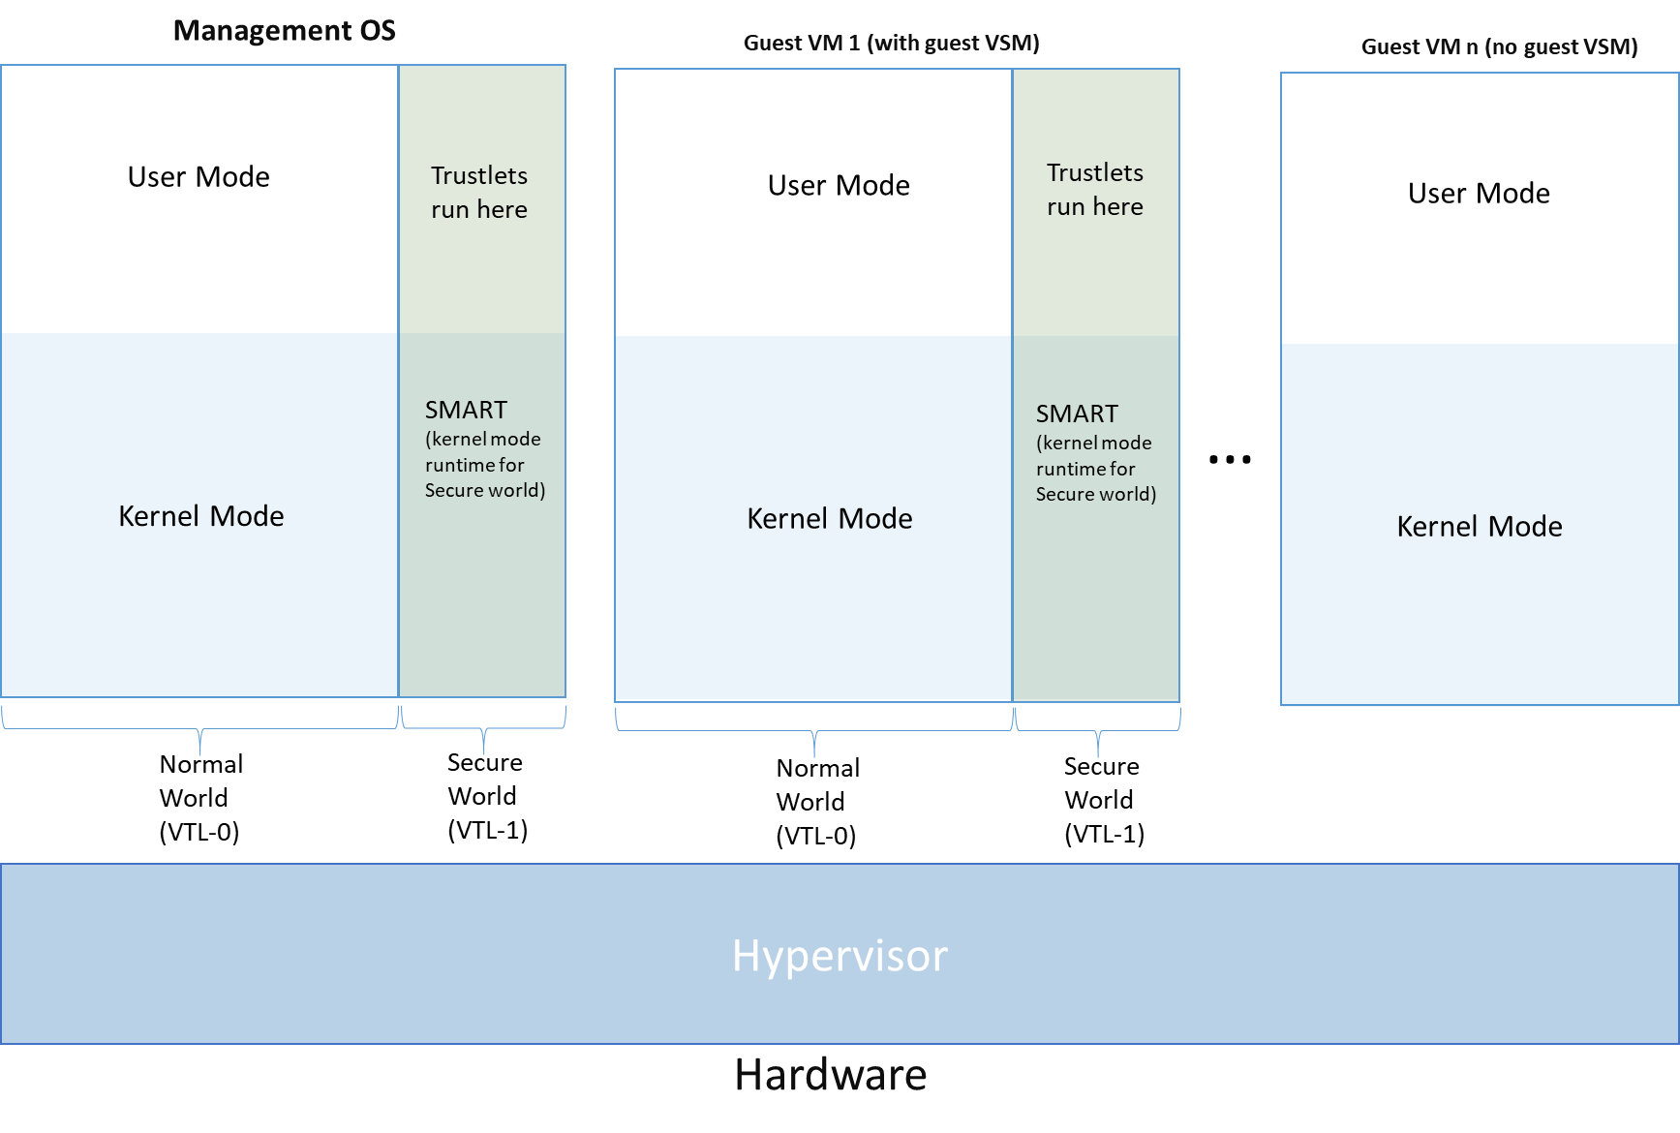
Hyper-V architectural change

Slide 31
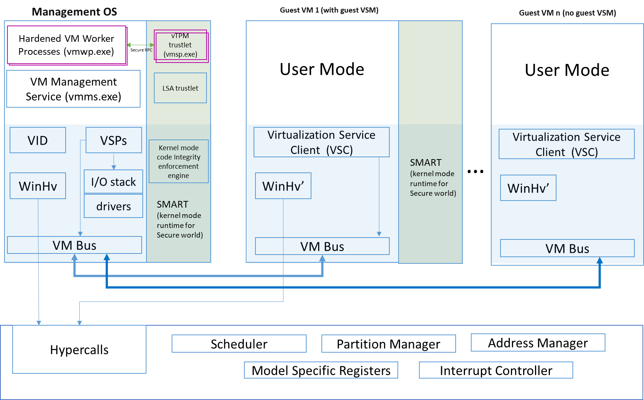
Hyper-V trustlets demo (vTPM & LSA)

Slide 32
Pre-Windows 10 security domains
Hyper-V Administrator
VM Administrator
The host admin is assumed to be a trusted entity. We do not go out of our way to block access to guest data.
VM
VM Management Service
Management OS kernel and device drivers
VM Worker Process
Hypervisor
Kernel Mode
User Mode

Slide 33
Windows 10 security domains
Hyper-V Administrator
VM Administrator
VM
Management OS normal world kernel and device drivers
VM Management Service
VM Worker Process
Hypervisor
Management OS secure world kernel (SMART) and Code Integrity enforcement engine
LSA trustlet
vTPM trustlet

Slide 34
Virtual Secure Mode
VSM is Microsoft’s virtualization-based security solution
VSM provides the basis for:
Secure runtime environment
Protected store
VSM is available to both server and client systems
No user interaction with VSM

Slide 35
VSM Protections

Slide 36
Virtual Secure Mode
Provides a new trust boundary for system software to:
Enhance platform security
Leverage platform virtualization to enforce strong access guarantees
Limit access to high-value security assets, even from code running in kernel mode
Provide a secure store and execution environment to enable:
Protected storage and management of platform security assets
Enhanced OS protection against attacks (including attacks from kernel-mode)
A basis for strengthening protections of guest VM secrets from the host OS

Slide 37
Uses of Virtual Secure Mode
Protect security assets
Authenticated user credentials
Security keys
Security policy
Attestation logs
Host services in isolation from the normal OS environment
Windows Security Applications (WSA) or “trustlets”
Code integrity enforcement
Attestation of host health

Slide 38
VSM platform recommendations
Virtualization extensions (Intel VT-x)
Second Level Address Translation (Intel Extended Page Tables, aka EPT)
IOMMU (Intel VT-d)
UEFI 2.3.1c or higher
Secure Boot
TPM v2.0

Slide 39
VSM memory isolation
VSM provides memory isolation from:
Accesses generated by system processors
DMA initiated from devices
Memory isolation is:
Based on Virtual Trust Levels, each with its own set of address space protections
Enforced by the hypervisor

Slide 40
Virtual Trust Levels
VSM implements trust boundaries via Virtual Trust Levels (VTL)
VTLs enhance existing processor privilege levels
VTLs provide memory isolation
Essentially, a set of access protections on physical memory
Enforced during the partition’s physical memory translation
VTLs cannot be changed from CPL0 in the partition

Slide 41
VTLs are hierarchical
Higher trust level == greater privilege level
Two trust levels for the initial VSM implementation:
VTL0 – Normal Mode, VTL1 – Secure Mode
Design accommodates > 2 VTLs
Higher VTLs control access privileges for lower levels
VTL1 can adjust memory access protections for VTL0

Slide 42
VSM memory isolation
Isolation from device accesses (DMA) enforced via IOMMU
Normal Mode devices share Normal Mode memory access protections
Cannot access Secure Mode memory

Slide 43
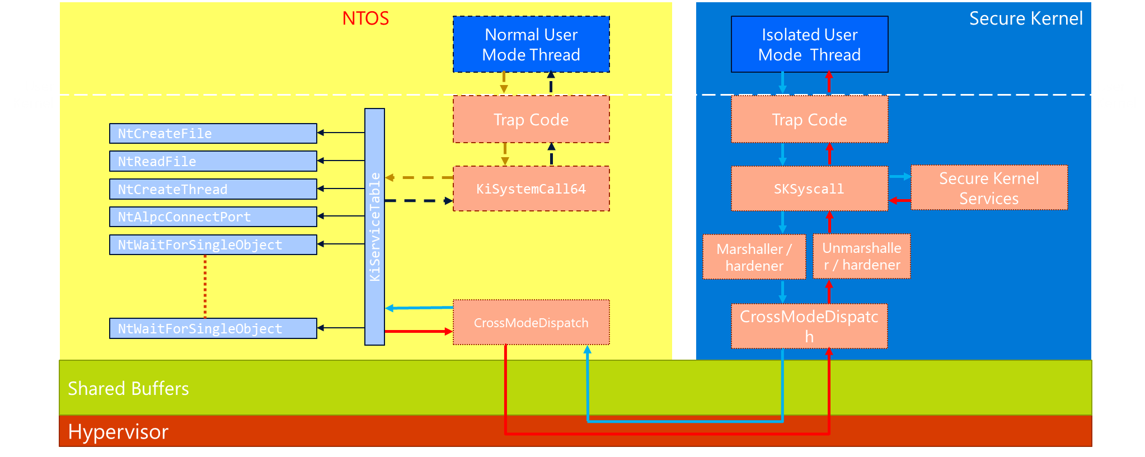
Secure Kernel

Slide 44
Hypervisor Enforced Code Integrity

Slide 45
Code Integrity Enforcement
Secure Boot
Ensures that everything that boots on a platform is signed by a trusted authority
Includes Secure Firmware Updates and “Platform” Secure Boot
Kernel Mode Code Integrity (KMCI)
Feature in Windows that ensures that any code running in kernel is signed by a trusted authority
Code Integrity
Native UEFI
Windows 8
OS Loader
Load Windows Kernel and Drivers
3rd Party Drivers
UEFI Secure Boot
KMCI

Slide 46
Hypervisor Enforced Code Integrity
Currently CI enforcement is done from within the Kernel​
If the Kernel is compromised any code can be executed​
For Hypervisor CI (HVCI) based systems enforcement will be in VSM​
Pages can only be marked executable from VSM after verification in VSM​
Eliminates most memory based attacks​
Reduces risk from 3’rd party drivers

Slide 47
Delegated trust Decisions
NT communicates through regular CI
All disk IO occurs in CI
Existing CI Boot Cache and Catalog EAs just work with HVCI
Trust decisions are offloaded to HVCI
Hash calculation
Certificate chain validation
Signature validation
Page verification

Slide 48
Worker Process

Slide 49
Hardening the worker process
A VMWP (named vmwp.exe) is created for each VM
The Virtual Machine Worker Process (VMWP) is started by the Virtual Machine Management Service (VMMS) when VMs are started
Primary functions of the VMWP:
VM lifecycle management (creating, configuring, running, pausing, resuming, saving, restoring and snapshotting)
Hosting of virtual devices
Handling interrupts from VM
Handling memory & I/O port mappings associated with VM
Has access to guest memory and can manipulate guest secrets

Slide 50
Possible attack vectors
Injecting a thread into the VMWP
Accessing the virtual memory of the VMWP
Attacker can attempt to map arbitrary VA range belonging to the VMWP, and thus access a VM’s memory to steal guest VM secrets
Debugging of the VMWP
Duplicating a handle from the VMWP

Slide 51
Hardened worker process
Run the worker process as a variant of a Protected Process for Virtual Machines that need protection from the host admin
Refactor access permissions to vmwp.exe handles to allow “just enough” access
Refactor the virtualization stack to remove duplicate handles to vmwp.exe
Code integrity enforcement

Slide 52
.
Part 3 – Threats mitigation
Learning Objectives
Understand how VBS mitigates certain security threats

Slide 53
Mitigations
Pass-the-Hash threats
Kernel malware threats
DMA attacks

Slide 54
Pass-the-hash attack
Pass-the-hash attacks works by stealing secrets from sensitive process’s memory (usually LSASS)
1.
Single IT Pro’s machine is compromised
IT Pro manages kiosks/shared devices on network
Attacker steals IT Pro’s access token
2.
Using IT Pros access token attacker looks for kiosk/shared devices and mines them for tokens
3.
Repeat

Slide 55


Pass-the-hash mitigation
Pass the Hash (PtH) attacks are the #1 go-to tool for hackers. Used in nearly every major breach and APT type of attack
Credential Guard uses VBS to isolate Windows authentication from Windows operating system
Protects LSA’s secrets and derived credentials (NTLM Hash)
Apps
Credential Guard
Trustlet #2
Trustlet #3
Windows Platform Services
Kernel
Kernel
Windows Operating System
Windows Defender System Guard
Hyper-V
Hyper-V
Device Hardware
Hypervisor

Slide 56
Mitigating untrusted code threats
Windows has support for code integrity since Windows XP
All code integrity mechanisms used to be implemented in the kernel
=>Consequently, CI is not able to protect itself against kernel malwares
Windows 10 allows moving crucial Code Integrity operations in the hypervisor.
Hypervisor don’t load any third-part module
Assumption is hypervisor extremely difficult to corrupt

Slide 57
DMA Attacks
Firewire and Thunderbolt communication technologies have known vulnerabilities to DMA attacks
DMA is a technology which enables a device to write directly into memory areas without solicitation of the CPU and, consequently, without operating system control
New hyper-v architecture leverages IOMMU component of the processor to restrict memory areas device can write to

Slide 58
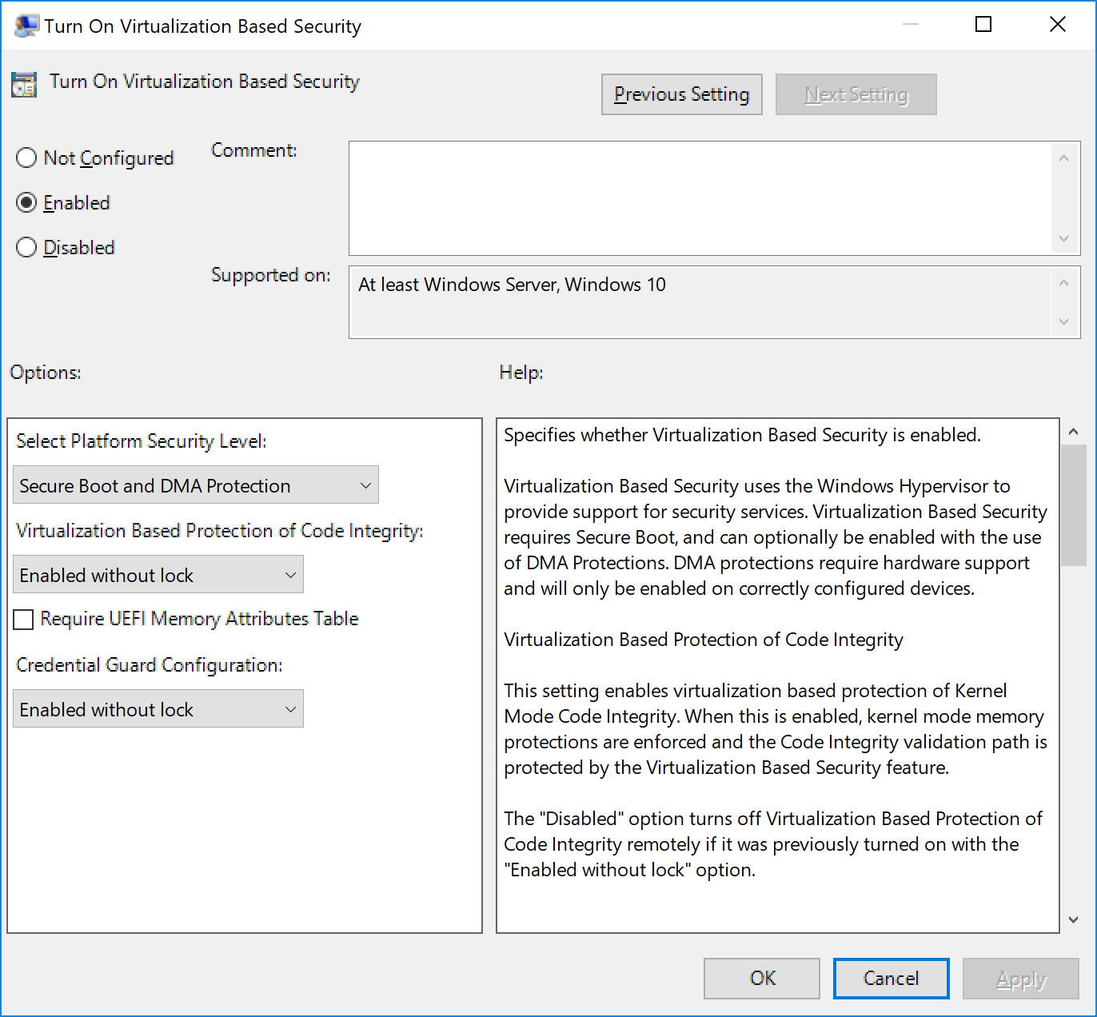
Enabling VSM based protections

